Slide 1
CHAPTER 3 Well posed predictive control 1 Introduction
Anthony Rossiter

Slide 2
Review of chapters 1 and 2
The first two chapters introduced concepts of prediction, optimisation and implementation and showed these made good intuitive sense.
Some specific MPC algorithms were defined and an analysis given for the constraint free case.
HOWEVER
These chapters neither engaged in discussions on whether the proposed MPC algorithms resulted in good closed-loop performance not considered how choices of horizons and weights might affect this.

Slide 3
Core questions
Are there good and bad choices for the input and output horizons.
Are their good and bad choices for the weights in the performance index.
Is the fundamental design of GPC/DMC sensible or do they contain theoretical flaws?
IT IS EASY TO SHOW THAT POOR CHOICES OF HORIZONS CAN LEAD TO VERY POOR BEHAVIOUR!
Discussion of constraints is left to a later chapter so as not to mix up the issues.

Slide 4
Illustration of poor behaviour
We will use MATLAB to show how deploying GPC alone, even in the constraint free, disturbance free and noise free case, is no guarantee of good behaviour.
Poor choices of horizons can result in ‘optimal’ strategies that are far from optimal.
Arbitrary choice of performance index.
Arbitrary choice of degrees of freedom.
Look at files
gpc3_1_example1.m
gpc3_1_example2.m
gpc3_1_example3.m

Slide 5
Same model, larger ny
SAME model, different ny
Rather oscillatory
UNSTABLE!

Slide 6
Questions
Why does GPC work well for some choices and not well for others?
Is there some underpinning explanation which would enable systematic design?
It is noted that, intuitively, if GPC is poor in the unconstrained case, it will not work well in the constrained case.
If particular SISO attributes cause problems, the same attributes and more could cause problems in the MIMO case.
Early authors tried to find mathematical relationships between stability and the horizons, but that approach is largely considered invalid nowadays.

Slide 7
Well posed optimisation
Rather than going straight to the well known solution, these videos will begin by trying to understand the MPC optimisation.
A good understanding will:
allow the user to always deploy sensible choices.
Moreover, this gives good insight into the normal recommendations in the literature.
Questions to be considered include guidance for the input and output horizons and also, whether the weightings are effective or not?

Slide 8
Going on a journey
Optimisation at step 1 was ill-posed or foolish as one was unable to get close to the trajectory we really wanted.
Also we keep changing our mind at each sample!
You need to get from A to B using GPC predictions with a control horizon of 2.
Step 1, using at most 2 turns, optimise your route to B, take 1st turn and move for 1 minute.
Step 2, from new position, re-optimise, again allowing two turns.
What if I had allowed more turns at the outset?
Just because I use an optimisation, does not mean the result is optimal. I might be solving a stupid optimisation.

Slide 9
Key insight – what is a well-posed optimisation?
The optimisation of J is only meaningful if the optimised trajectories are close to the closed-loop responses that result. We cannot keep changing our mind!
If the optimised predictions differ significantly from the closed-loop behaviour, then the predictions are meaningless and thus the optimisation is meaningless as they do not represent what is actually going to happen.
If the predictions are not close to what we really want, the optimisation is also meaningless. The desired behaviour must be in the class of predictions over which we optimise.
Examples will show that there is a close match between predictions, desired behaviour and closed-loop behaviour, if and only if some conditions are met.

Slide 10
Aside – feed forward
The first few videos will assume there is no advance information on the target, so in essence the feed forward P_{r} is a constant and the target is assumed constant.
Discussions on how ‘tuning’ guidance might change when advance information on the target is available is delayed until later so as not to confuse core concepts.

Slide 11



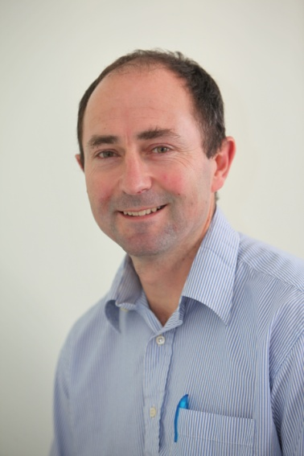
Anthony Rossiter
Department of Automatic Control and Systems Engineering
University of Sheffield
www.shef.ac.uk/acse
© 2014 University of Sheffield
This work is licensed under the Creative Commons Attribution 2.0 UK: England & Wales Licence. To view a copy of this licence, visit http://creativecommons.org/licenses/by/2.0/uk/ or send a letter to: Creative Commons, 171 Second Street, Suite 300, San Francisco, California 94105, USA.
It should be noted that some of the materials contained within this resource are subject to third party rights and any copyright notices must remain with these materials in the event of reuse or repurposing.
If there are third party images within the resource please do not remove or alter any of the copyright notices or website details shown below the image.
(Please list details of the third party rights contained within this work.
If you include your institutions logo on the cover please include reference to the fact that it is a trade mark and all copyright in that image is reserved.)

